Slide 1

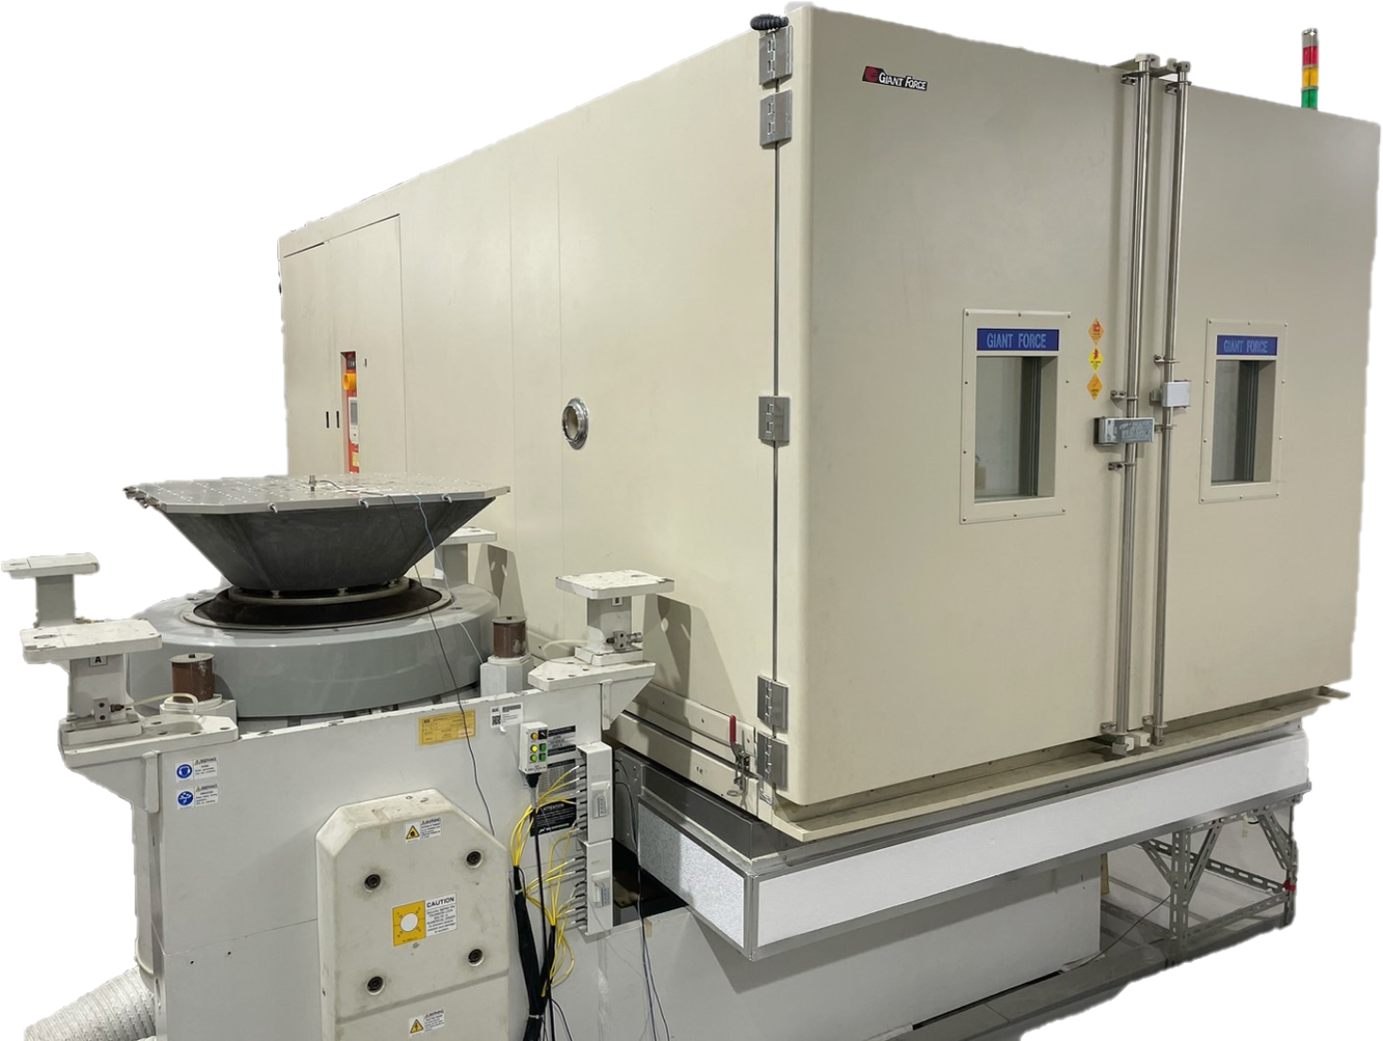
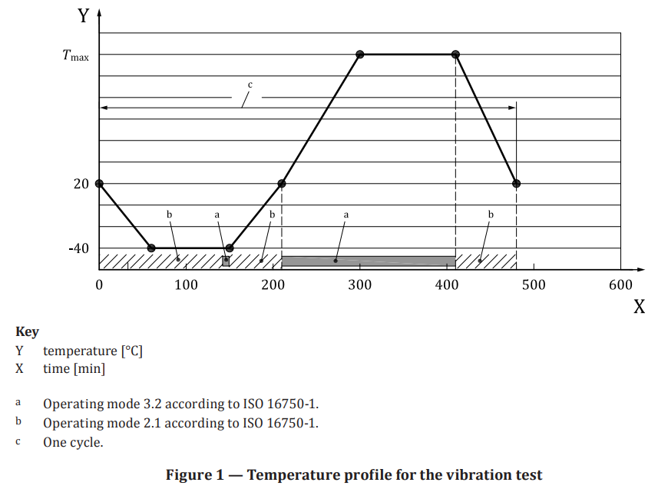
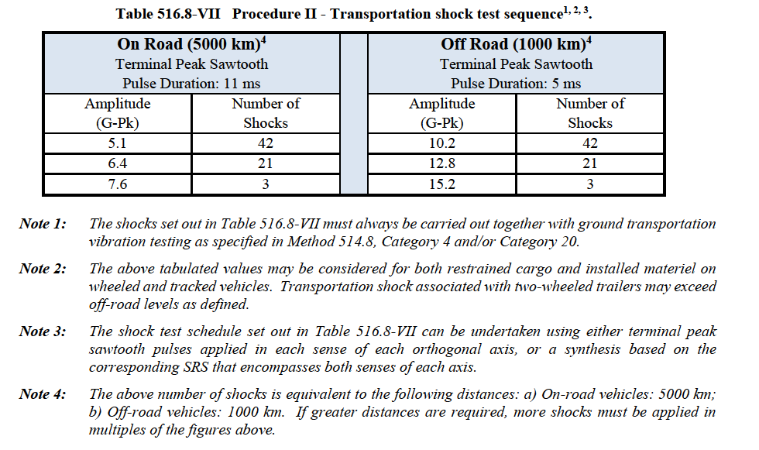

Thermal Vibrational Test Equipment
Introduction
Test Procedure
Specially engineered systems deliver stress of rapid thermal cycling and random vibration which are used to rapidly reveal design weaknesses and product problems.
Stresses are usually delivered in an ordered sequence:
Ex : Combined Environment
- Rapid Thermal Cycling
- Vibration Step Stress
According to standard
- IEC 60068-2-6
- IEC 60068-2-64
- MIL-STD-810H
- ISO 16750-3
- ISTA 1 Series、ISTA 2 Series、ISTA 3
Series、ISTA 6 Series…
Temperature Range : -40 ℃ ~ 150 ℃
Relative Humidity : 10 %R.H ~ 95 %R.H
Vibration Frequency : 1 Hz ~ 2000 Hz
Vibration Force : 5000 kgf
Table Size :
XY axis -- 120 cm × 120 cm / 400 kg
(M10, Hole spacing 5 cm)
Z axis -- 80 cm × 80 cm / 180 kg
(M10, Hole spacing 10 cm)
Z axis -- 180 cm × 70 cm / 400 kg
(M10, Hole spacing 10 cm)
Table Chamber :
195cm (W) × 160cm (H) × 200cm (D)
Test Principle
The Thermal vibration tester can imitate the natural environment, warm humidity and vibration change and injury of the products of three kinds of physical quantities, and to the adaptability of the environment by already assessing the reliability of the products, so can carry on the warm humidity to changes and shakes at random at the same time, find out some of limit of the products and products flaw.

Slide 2
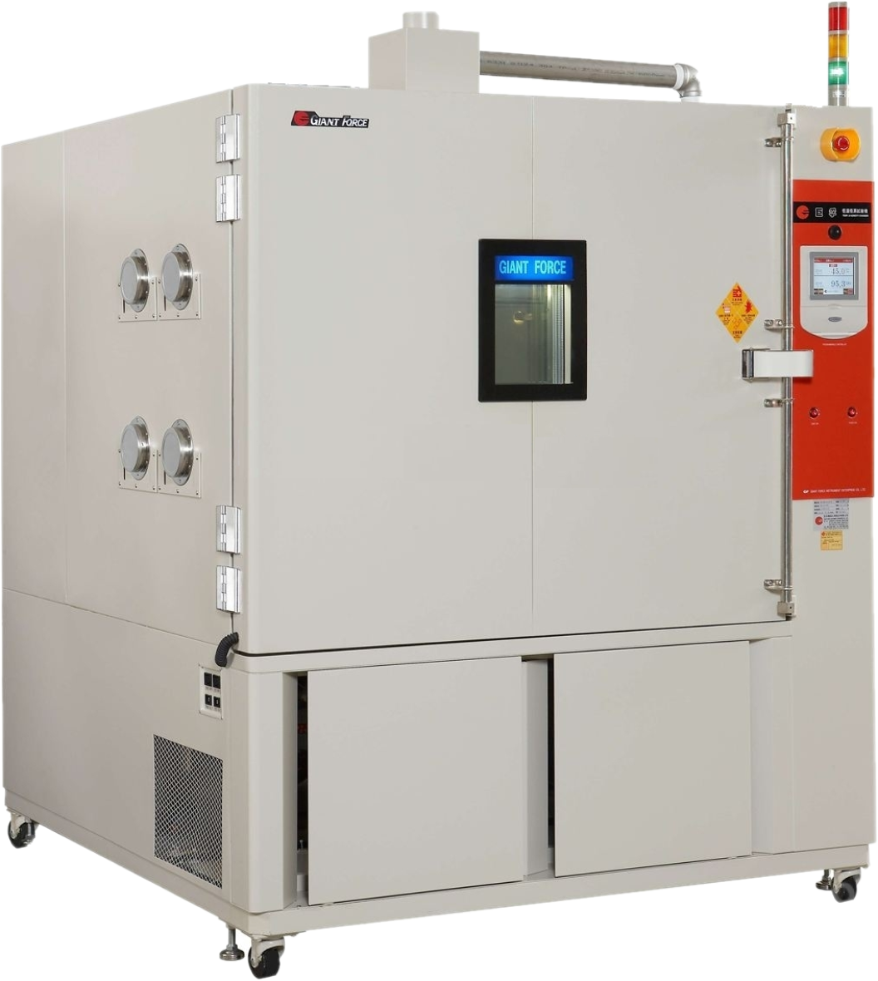
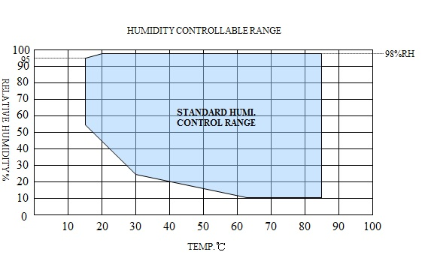
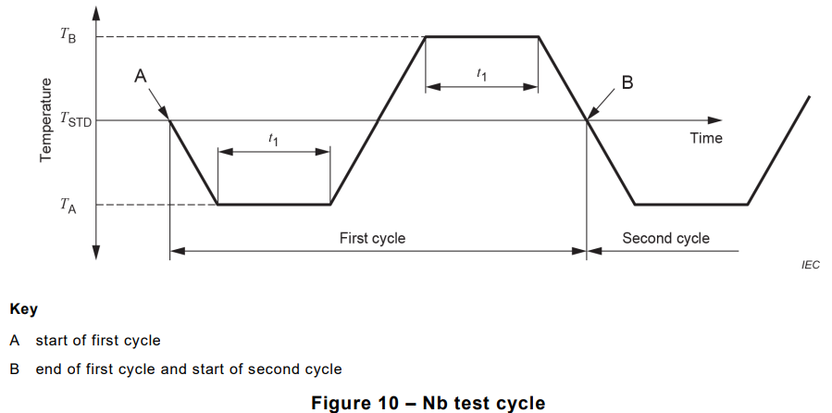
Temperature and Humidity Test Chamber
Introduction
Test Procedure
Conduct a series of high and low temperature cycle tests on temperature changes at a temperature change rate of 1 to 5 degrees per minute.
According to standard
- IEC 60068-2-1
- IEC 60068-2-2
- IEC 60068-2-14
- IEC 60068-2-30
- IEC 60068-2-38
- IEC 60068-2-78
- MIL-STD-810H
- ISO 16750-4
Model No. :
GIANT FORCE GTH-1000-60-CP-AR-H
Temperature Range : -60 ℃ ~ 150 ℃
Relative Humidity : 10 %R.H ~ 95 %R.H
Chamber Size :
100 cm (W) × 100 cm (H) × 100 cm (D)
GIANT FORCE GTH-1000-60-CP-AR15
Temperature Range : -60 ℃ ~ 150 ℃
Temperature Change Rate : 15 ℃/min
Chamber Size :
100 cm (W) × 100 cm (H) × 100 cm (D)
Test Principle
During the life cycle of a product, it will face various environmental conditions, which will expose the fragile parts of the product, causing damage or failure of the product, thereby affecting the reliability of the product.
These two tests are not just about simulating actual conditions, but one of their purposes is to apply stress to the object to be tested, accelerate the aging factor of the sample, and allow the sample to identify components or materials that may be damaged under environmental factors to determine whether the sample has been damaged. Correctly designed or manufactured.

Slide 3
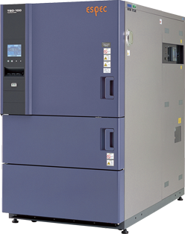
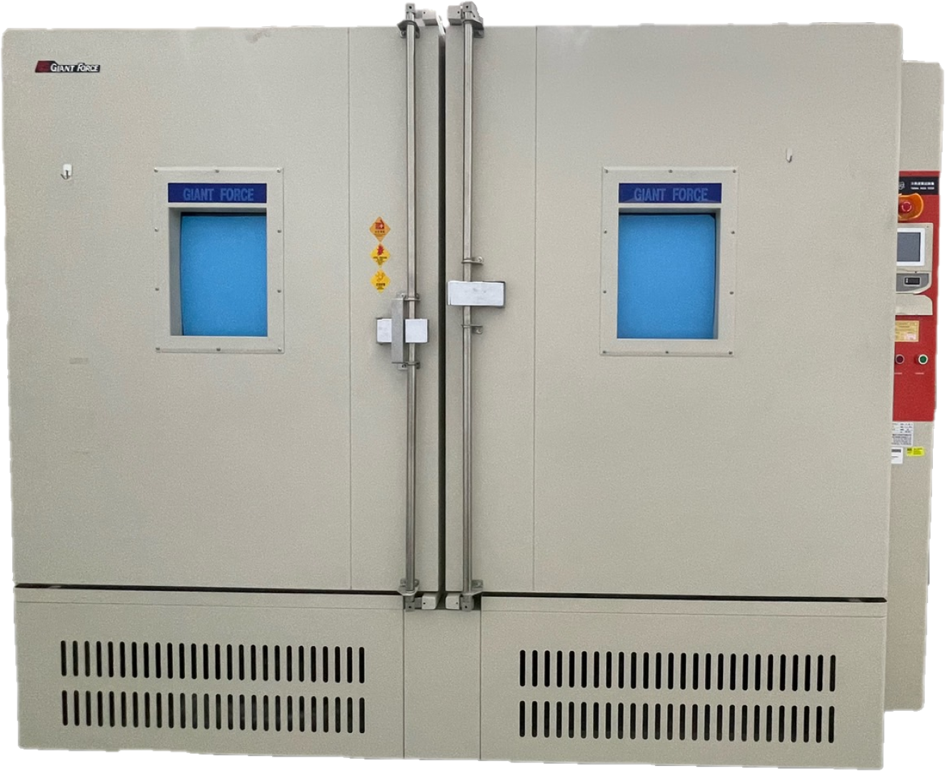
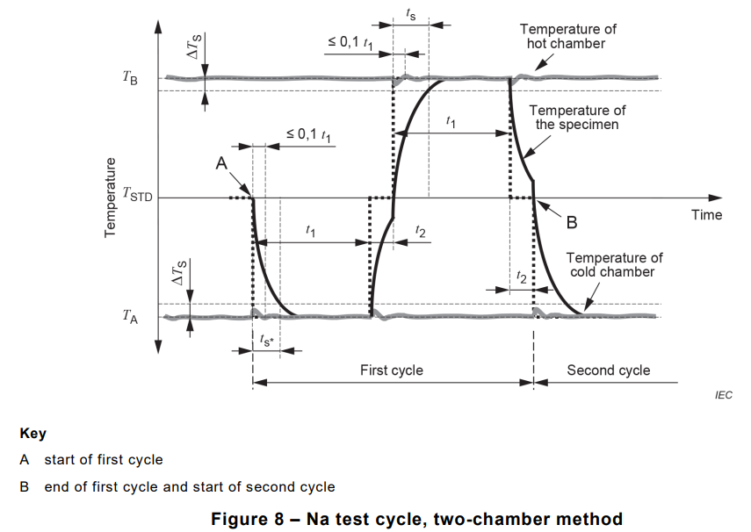
Thermal Shock Test Chamber
Introduction
Test Principle
Thermal shock test can be used to test the material structure or composite materials, in an instant by the very high temperature and very low temperature, whether it can withstand the extent of continuous environment in order to test if there is any chemical changes or physical hurtcaused by the thermal expansion and contractionin the shortest possible time
Test Procedure
Model No. : ESPEC TSD-100
Temperature Range : -65 ℃ ~ 200 ℃
Temperature Transition Time : ≦1 minute
Chamber Size :
71 cm (W) × 41 cm (H) × 34.5cm (D)
With a temperature change rate of more than 40 degrees per minute, high and low temperature shock tests are conducted under extremely harsh conditions on rapid temperature changes.
The test method includes an air tank type device that uses air to change temperature, temperature change time must be controlled to be completed within 60 seconds.
According to standard
- IEC 60068-2-14
- MIL-STD-810H
Model No. :
GIANT FORCE GTST-720-65-AW-2
Temperature Range : -40 ℃ ~ 150 ℃
Temperature Transition Time : ≦1 minute
Chamber Size :
70 cm (W) × 70 cm (H) × 160 cm (D)
GIANT FORCE GTST-1800-65-AW-2
Temperature Range : -50 ℃ ~ 150 ℃
Temperature Transition Time : ≦1 minute
Chamber Size :
100 cm (W) × 100 cm (H) × 180 cm (D)

Slide 4
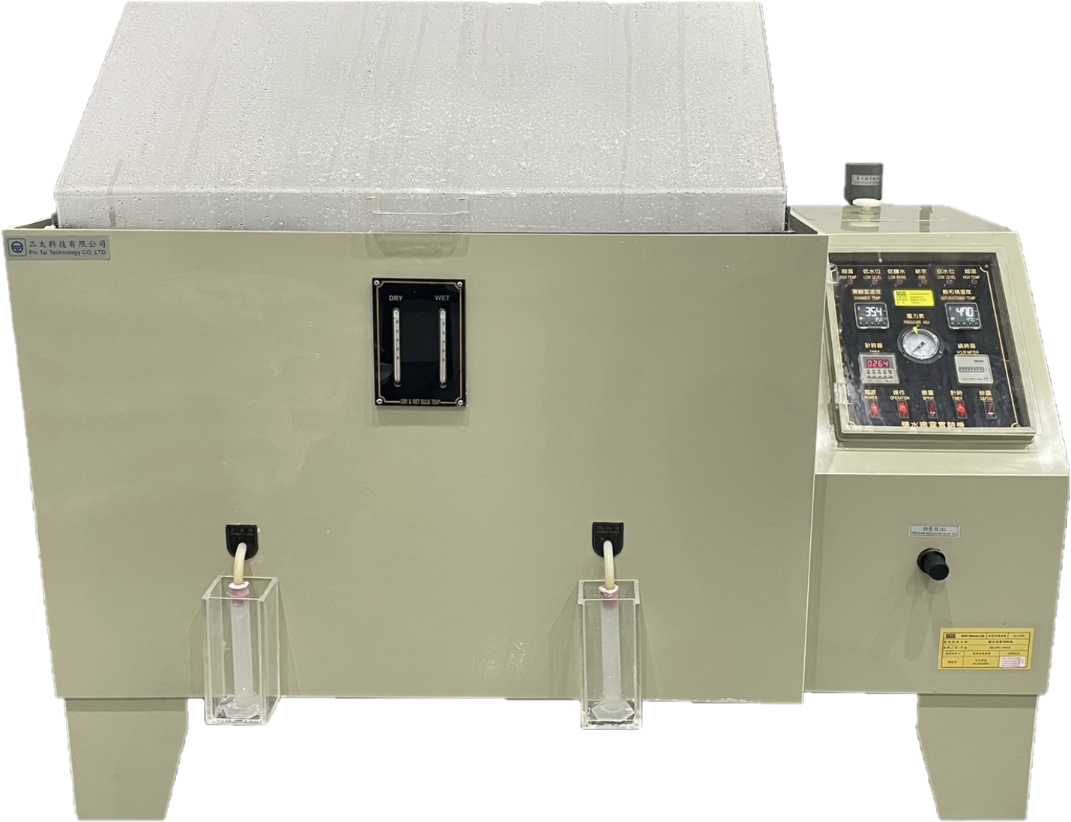
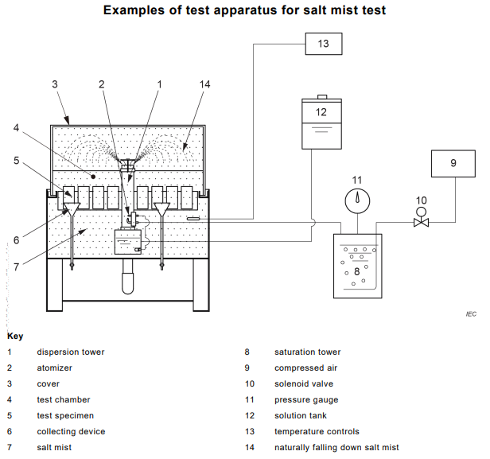
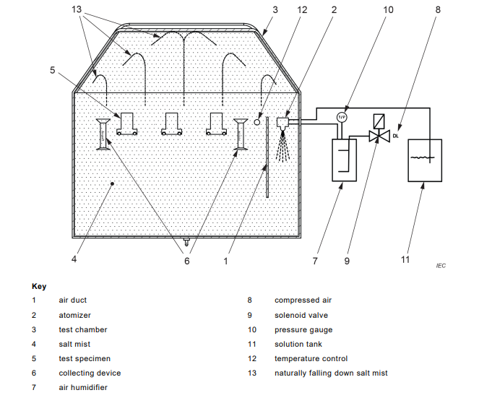
Salt Spray Test Equipment
Introduction
Test Procedure
According to standard
- IEC 60068-2-11 Ka
- IEC 60068-2-52 kb (Method 1、2)
- ASTM B117
- ISO 9227 (NSS test)
- CNS 8886
- ISO 16750-4
Model No. : Pin Tai SSL-S90
Salt solution : (5 ± 1) wt.% NaCl solution
PH of solution : 6.5 to 7.2
Temperature : (35 ± 2) ℃
Quantity of fog :
(1.0 ~ 2.0) ml/ 80 cm²/ hour
Chamber Size :
90 cm (L) × 60 cm (W) × 50 cm (H)
Test Principle
It is suitable for testing various metal materials and products. After anti-corrosion treatments such as paint coating, electroplating, inorganic and organic films, anodizing, and anti-rust oil, the product's salt spray corrosion resistance is tested.

Slide 5

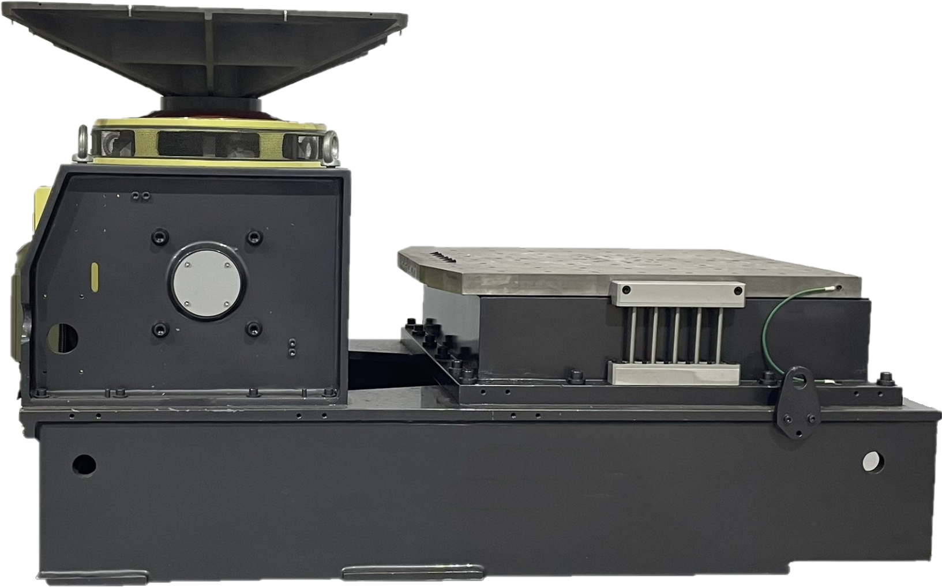
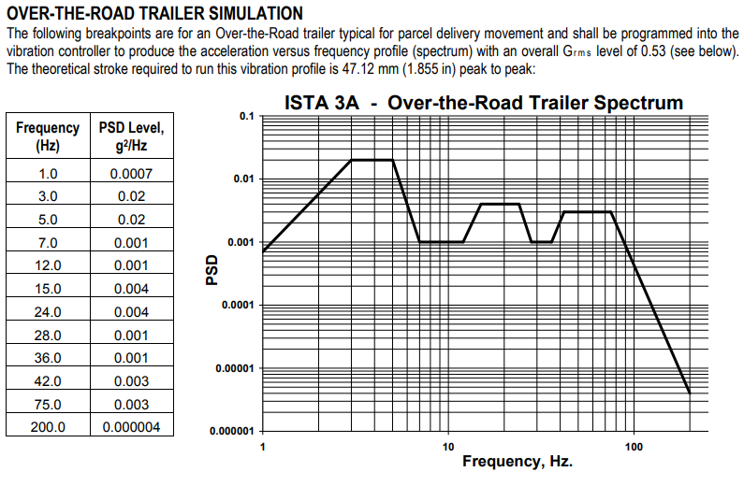
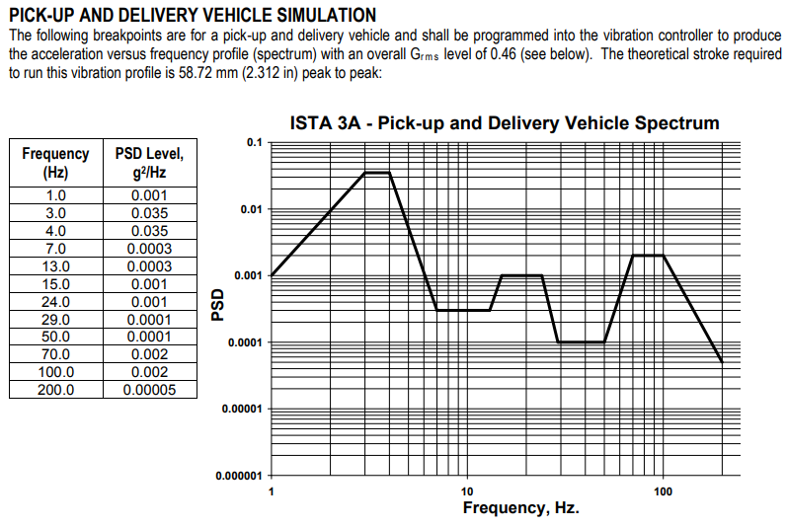
Vibrational Test Equipment
Introduction
Test Procedure
Vibration testing analyzes the following parameters, typically in the frequency domain, to understand the condition of the test object:
Velocity is the speed at which an object moves in a given direction during the test period.
Acceleration measures how quickly movement picks up speed in a given period.
Displacement is the distance the measuring point has moved during the testing period.
According to standard
- IEC 60068-2-6
- IEC 60068-2-64
- MIL-STD-810H
- ISO 16750-3
- ISTA 1 Series、ISTA 2 Series、ISTA 3
Series、ISTA 6 Series…
Vibration Frequency : 1Hz ~ 2000Hz
Vibration Force : 1000 kgf
Table Size :
XY axis -- 84 cm × 80 cm (M10, Hole spacing 10cm)
Z axis -- 80 cm × 80 cm (M10)
Z axis -- 30 cm × 30 cm (M10, Hole spacing 5cm)
Test Principle
The significance and purpose of vibration test：
Test for fatigue damage：About 80% of the structural damage we experienced is fatigue damage, while the impact is momentary strength damage.
In a vibration environment, whether the product fails, the accuracy of the instrument is reduced, the parameters of component change, parts loosening, sealing damage, and so on.

Slide 6
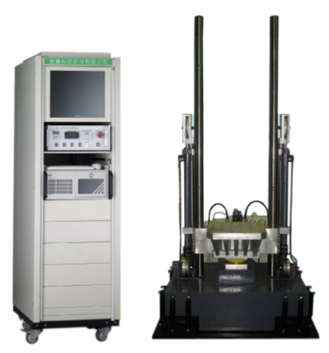
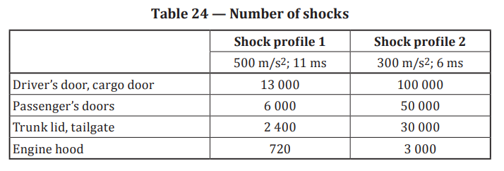
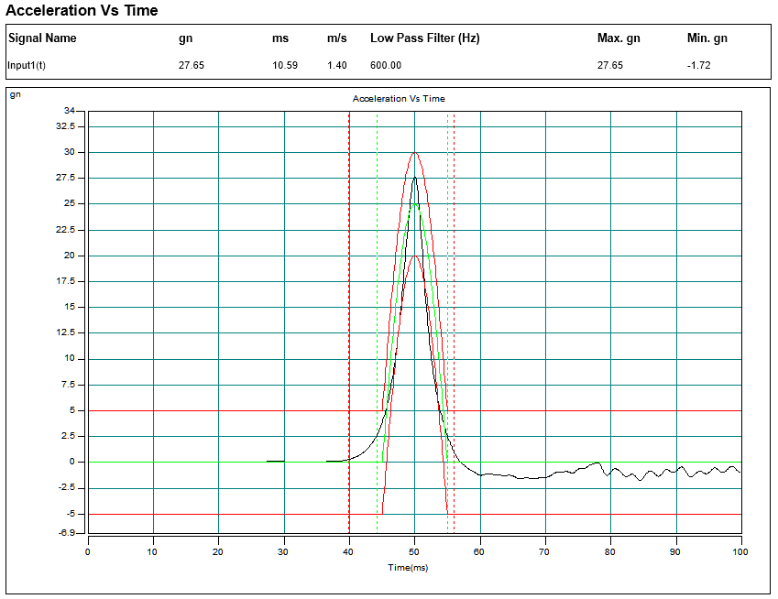
Mechanical shock Test Equipment
Introduction
Test Procedure
Mechanical shock test used to determine the ability of a sample to withstand non-repetitive or repeated impacts of a specified intensity. The purpose of this test is to reveal mechanical weaknesses or deterioration in specified properties or cumulative damage or deterioration caused by impact.
According to standard
- IEC 60068-2-6
- IEC 60068-2-64
- MIL-STD-810H
- ISO 16750-3
- ISTA 1 Series、ISTA 2 Series、ISTA 3
Series、ISTA 6 Series…
Pulse Shape : Half-Sine
Peak acceleration : 15 g ~ 100 g
Pulse Duration : 3 ms ~ 25 ms
Table Size :
50 cm × 48 cm (M12, Hole spacing 8cm)
Test Principle
Mechanical shock test machine is designed to simulate the transport environment non-repetitive high impact conditions, through the impact of the appropriate application, to detect the transport of weaknesses and certain features of the degradation of the situation.
This will help to understand the structural strength and the impact resistance, drop resistance of the appearance, and prevention from the fall based on the characteristics of products, to analyze the strength of the withstand of impact environment, and to effectively prevent the occurrence of product damage.

Slide 7
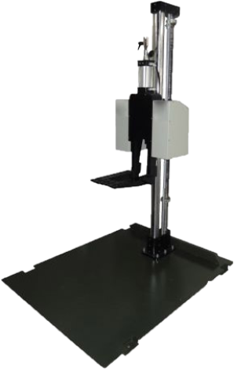
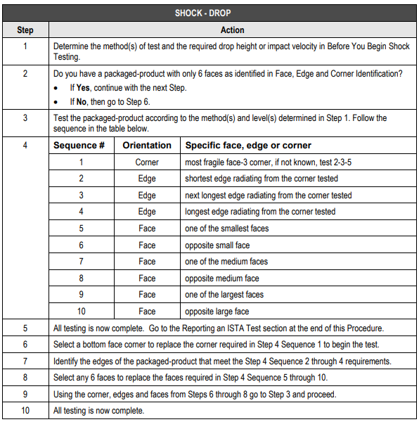
Drop Test Equipment
Introduction
Test Procedure
Cushion packaging design, packaging material selection, packaging contend design, drop specifications test.
According to standard
- IEC 60068-2-31
- IEC 60068-2-32
- MIL-STD-810H
- ISO 16750-3
- ISTA 1 Series、ISTA 2 Series、ISTA 3
Series、ISTA 6 Series…
Drop height : 30 cm ~ 130 cm
Test surface :
Steel plate (150 cm × 125 cm , Thickness 1 cm)
Concrete plate
(60 cm × 60 cm, Thickness 10 cm)
Test Principle
The test aims for the products that have been packaged. It is important to determine whether the packaging design can be improved by measuring the shock-proof, cover-fullness, and adequacy of the product's durability to drops. The use of packaging equipment is to help customers to purchase from shelf spot, based on the acceptance of the test categories to determine whether it is in line with their own need, and whether it is good or bad in the market of similar products.

Slide 8
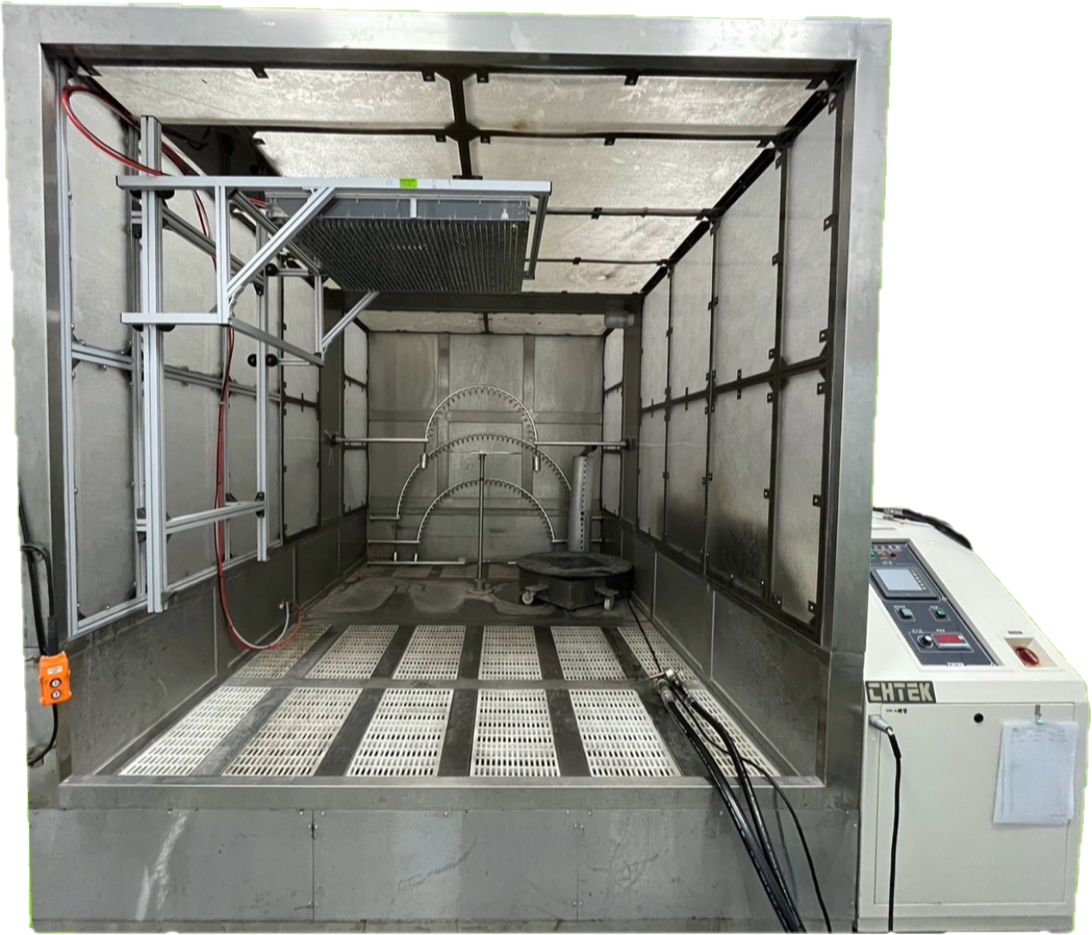
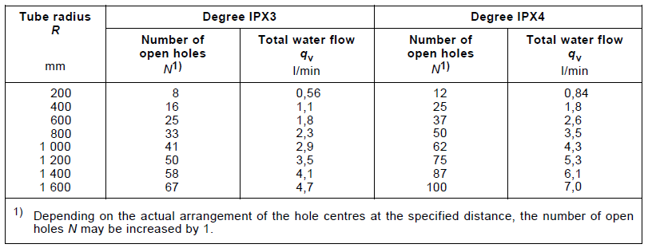
Water Ingress Protection Test Equipment
Introduction
Test Principle
IP test standard determines the product's ability to protect against solid objects and liquids (anti-solid intrusion, dust-proof, waterproof).
These tests provide a numerical representation of a product's protective capabilities based on IP ratings. For example, IP11 to IP68 levels represent different levels of protection capabilities.
Model No. :
CHTEK CH-2010-S6
IP Code Level : IPX1 ~ IPX6
M-2000L Immersion Tank
IP Code Level : IPX7 ~ IPX8
Specification:
Inner diameter: 131 cm
Bottom: 118 cm
Height: 164 cm
(The maximum water depth that IPX8 can
perform the test)
Test Procedure
According to standard
- IEC 60529
- IEC 60598-1 Section 9
- ISO 20653

Slide 9
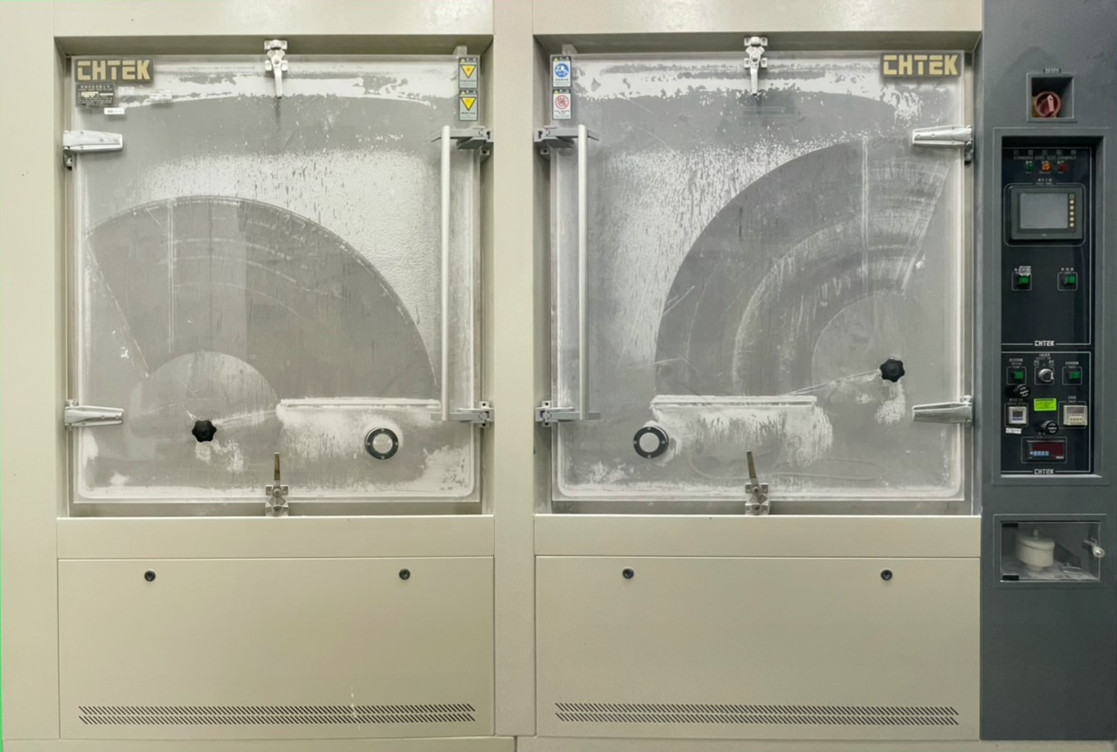
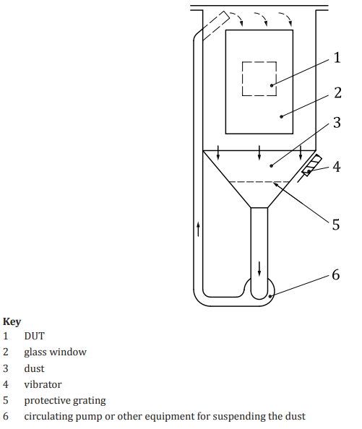
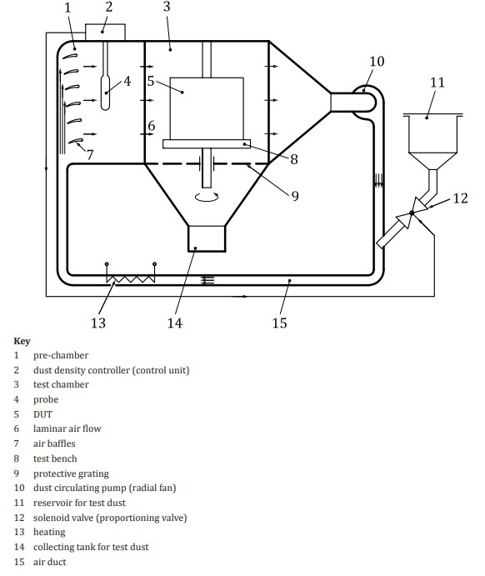
Dust Ingress Protection Test Equipment
Introduction
Test Procedure
According to standard
- IEC 60529 (Talcum Powder)
- IEC 60598-1 Section 9 (Talcum Powder)
- ISO 20653 (Arizona dust )
Model No. : 3
CHTEK CH-7139-CF-20
IP Code Level : IP1X ~ IP6X
Powder Type : Talcum Powder
Chamber Size :
220 cm (W) × 115 cm (H) × 110 cm (D)
CHTEK CH-7139-CF8
IP Code Level : IP1X~ IP6X
Powder Type :
Arizona dust (According ISO 12103-1)
Chamber Size :
200 cm (W) × 190 cm (H) × 200 cm (D)
Test Principle
IP test standard determines the product's ability to protect against solid objects and liquids (anti-solid intrusion, dust-proof, waterproof).
These tests provide a numerical representation of a product's protective capabilities based on IP ratings. For example, IP11 to IP68 levels represent different levels of protection capabilities.

